Slide 1
Final Thesis
Suitability of Modern Wi-Fi for Wireless Infield-Communication
Karl Lautenschläger
Notes:
<number>
2/7/23

Slide 2
Agenda
Motivation Final Thesis
Physical Layer Technologies
Field Measurements
Simulation Experiments

Slide 3
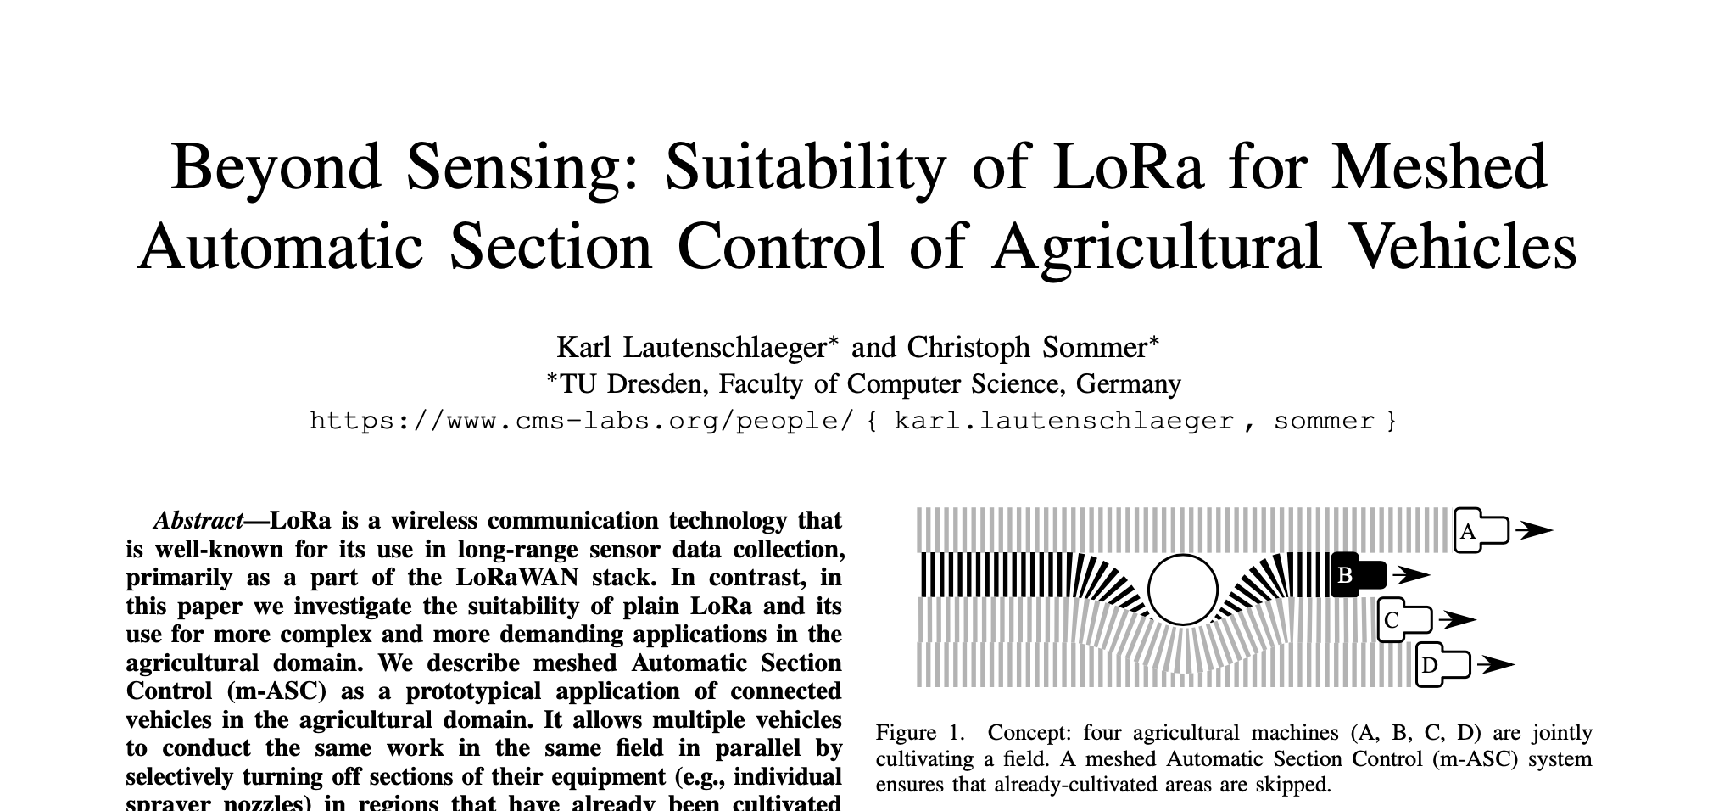
Background
December 2020 – April 2021: Undergraduate thesis about Suitability of LoRa for Meshed Automatic Section Control of Agricultural Vehicles
<number>
Notes:
<number>

Slide 4
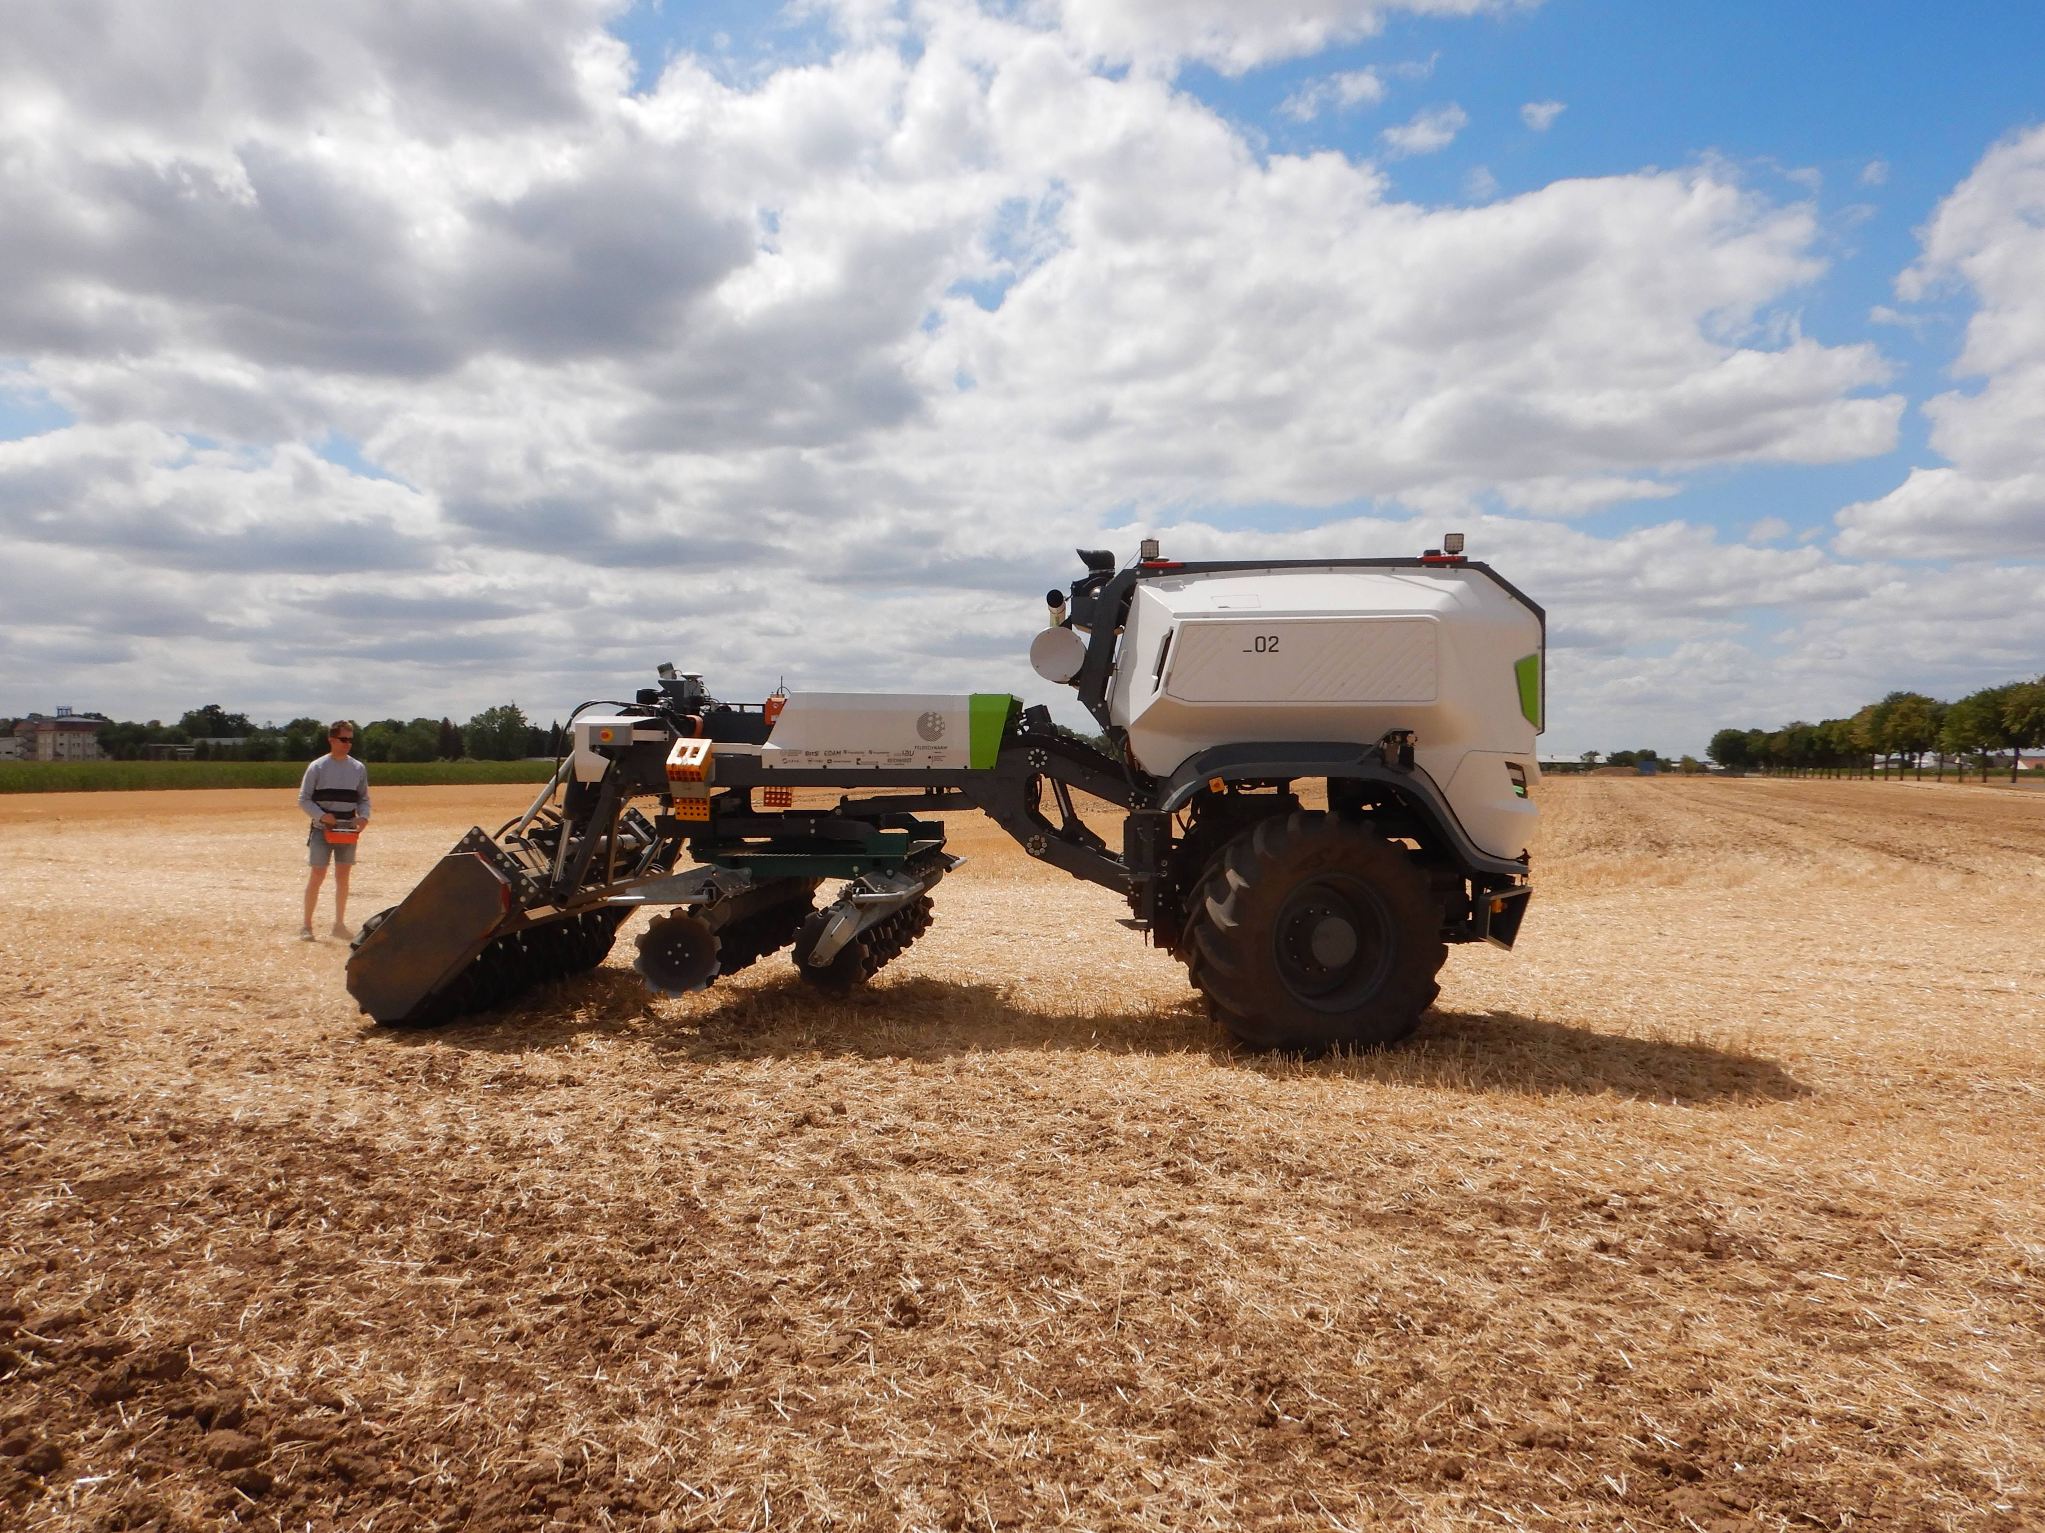
Background
March 2022 – August 2022: Intern at the Feldscharm project
<number>
Notes:
<number>

Slide 5
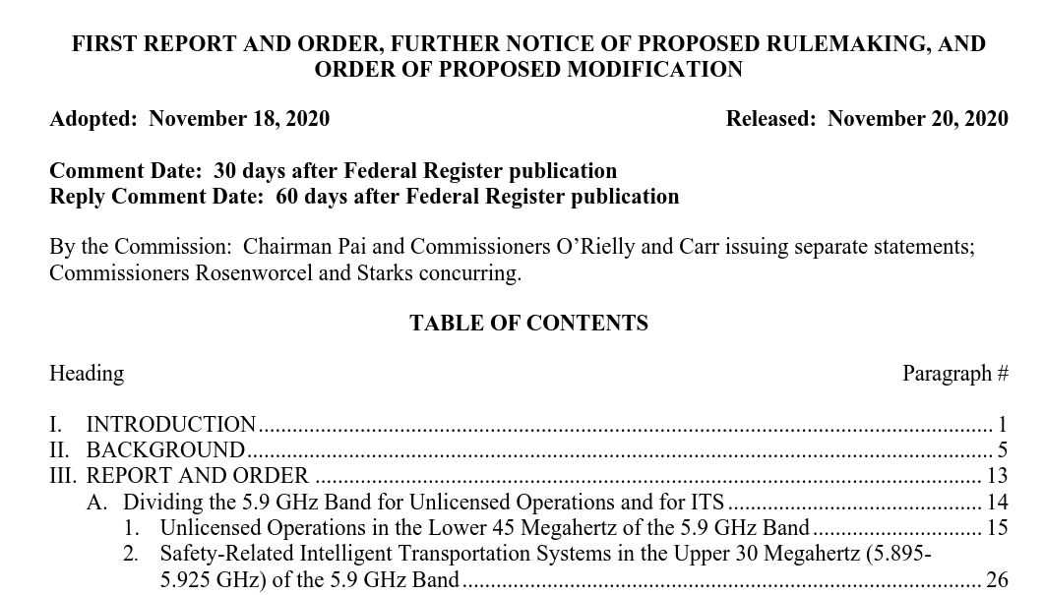
Motivation Final Thesis

Slide 6
Modern Wi-Fi
 | IEEE 802.11ac (Wi-Fi 5) | IEEE 802.11ax (Wi-Fi 6)
Spectrum | 5 GHz | 2.4 GHz, 5 GHz
Bandwidth | Up to 160 MHz | Up to 40 Mhz (2.4 GHz), 160 Mhz at 5 GHz
OFDM Guard Interval | 0.4 or 0.8 μs | 0.8, 1.6 or 3.2 μs
Maximal Data Rate | 6.9 Gbit/s | 9.6 Gbit/s
Max Modulation Coding Scheme | 256-QAM | 1024-QAM
Multi-User Technology | MU-MIMO | MU-MIMO, OFDMA
Multi-User Transmission Direction | Downlink | Downlink und Uplink
K. Lautenschlaeger, Suitability of Modern Wi-Fi for Wireless Infield-Communication
<number>
Notes:
<number>

Slide 7
Physical Layer Technologies

Slide 8
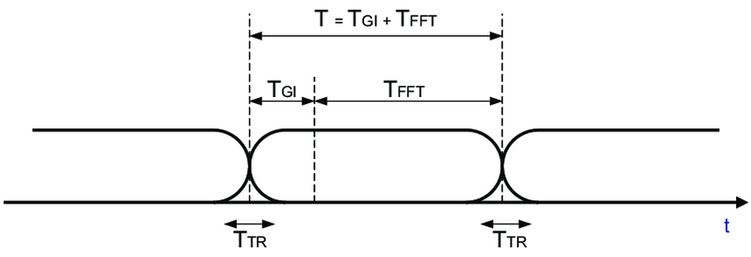
OFDM Guard Interval
Wi-Fi Standard | OFDM Guard Interval | Bandwidth attenuation = 100 * T_{FFT} / T [%]
Wi-Fi 4 & 5 | 400 ns | 89 %
Wi-Fi 4 & 5 | 800 ns | 80 %
Wi-Fi 6 | 800 ns | 94 %
Wi-Fi 6 | 1600 ns | 89 %
Wi-Fi 6 | 3200 ns | 80 %

Slide 9
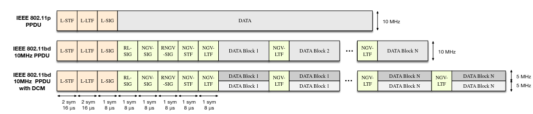
Dual Carrier Modulation (DCM)

Slide 10
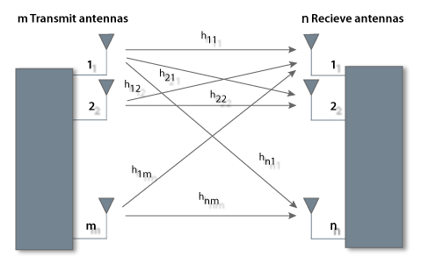
Multiple Input Multiple Output (MIMO)

Slide 11
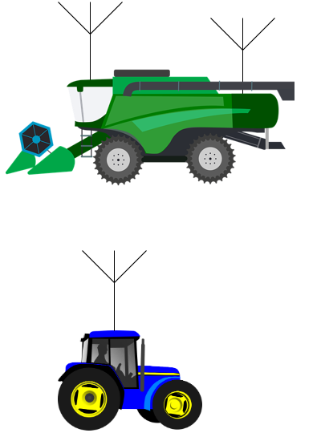
Space-Time-Block-Codes
Increases robustness
Decreases data date

Slide 12
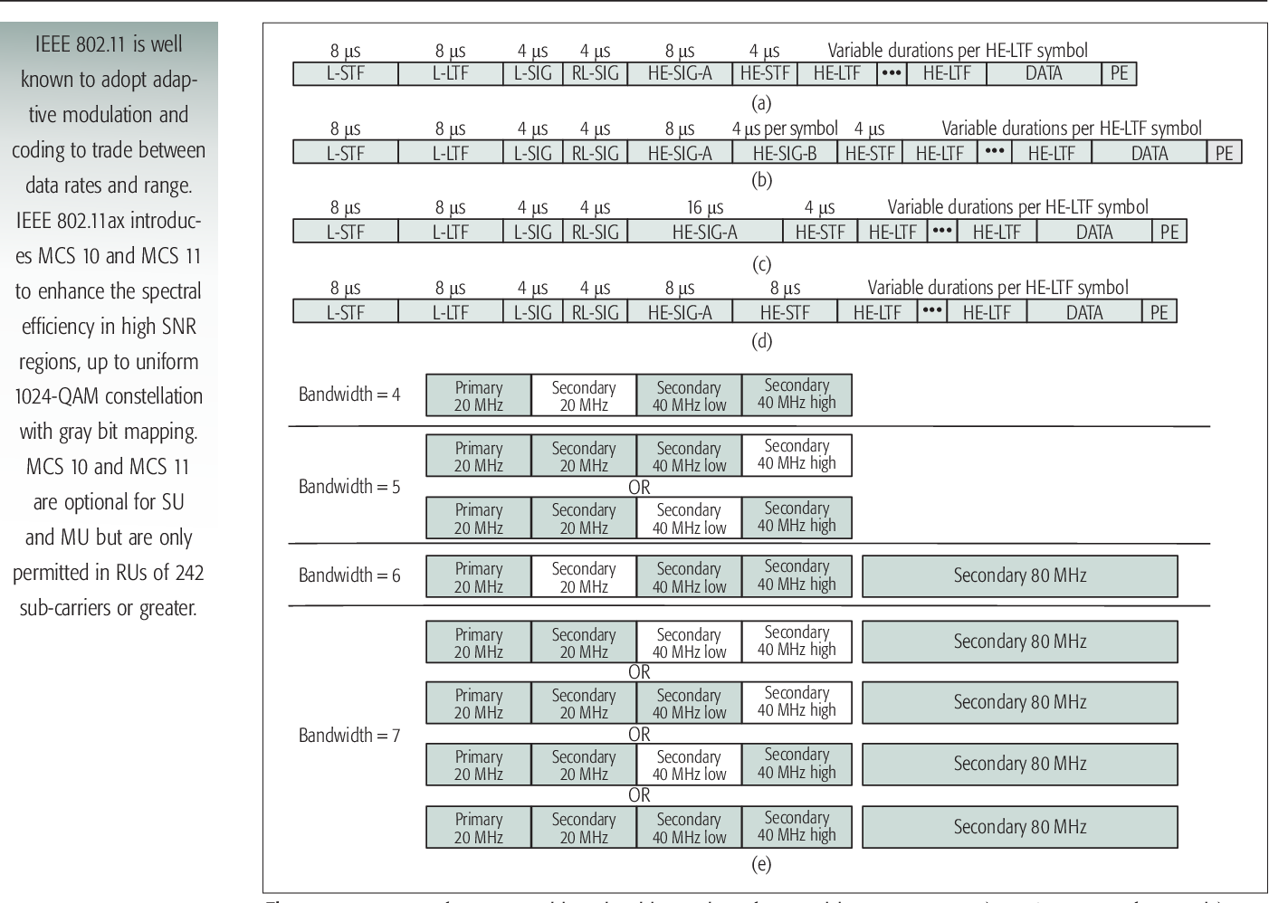
Extended Range Mode
Available for 802.11ax, 802.11bd
Preamble power-boosting up to 3 db
HE SU PPDU Format
HE Extended Range SU PPDU Format

Slide 13
Bandwidth in 5 GHz Frequency Range
Wi-Fi Standard | Bandwidth | Transmission Power Extend for transmission power CSX
802.11 p, 802.11bd | 10 MHz | 33 dbm 802.11p, 802.11bd
802.11 bd, 802.11ax, 802.11ac | 20 MHz | 33 dbm 802.11bd 30 dBm 802.11ax, ac 50 mW / MHz
802.11ax, 802.11ac | 40 MHz | 25 mW / MHz
802.11ax, 802.11ac | 80 MHz | 12.5 mW / MHz
802.11ax | 80 + 80 MHz | 6.25 mW / MHz
802.11ax | 160 MHz | 6.25 mW / MHz

Slide 14
Range
Throughput
Robustness

Slide 15
Field Measurements

Slide 16
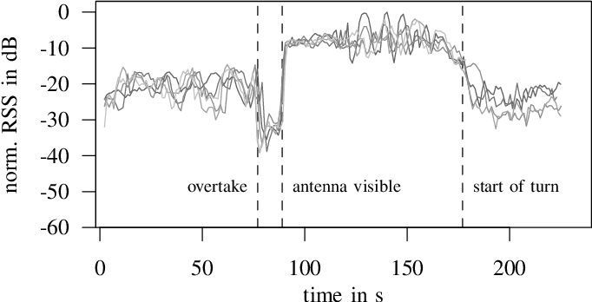
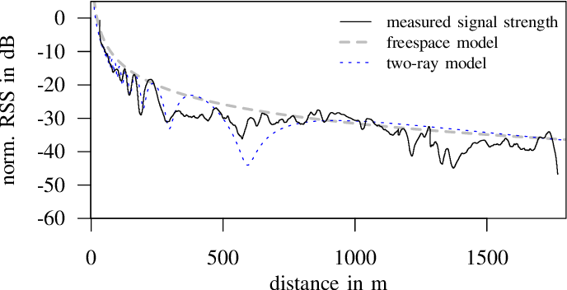
Motivation
Field Measurements
From F. Klingler, J. Blobel, and F. Dressler, “Agriculture meets IEEE 802.11p: A
Feasibility Study,” DOI: 10.1109/ISWCS.2018.8491239.
14
Notes:
<number>

Slide 17
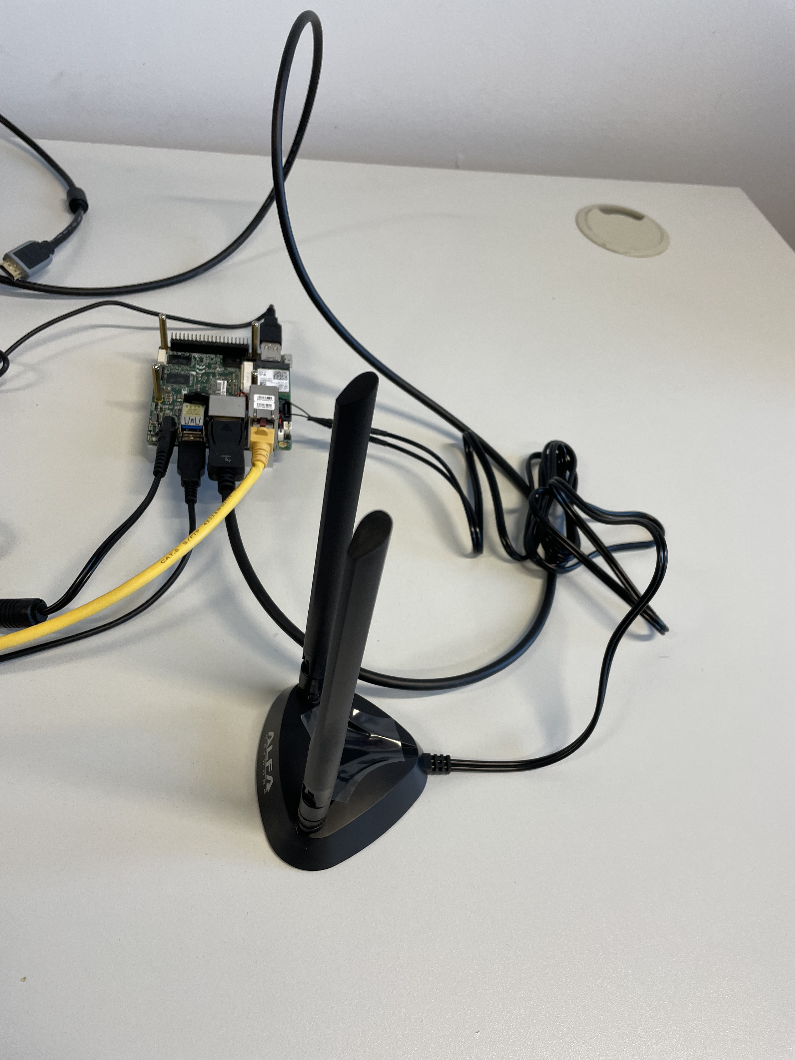
Field Measurements Equipment
Wi-Fi 6E Chips Intel AX210
Universal Software Radio Peripheral B 200
Industrial Router Milesight UR75
<number>
Notes:
<number>

Slide 18




Field Experiments
communication range
<number>
Notes:
<number>

Slide 19
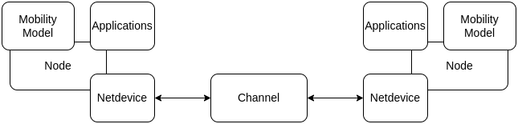
Network Simulation

Slide 20

Simulation
Harvest Platooning Service
K. Lautenschlaeger, Suitability of IEEE 802.11ax \ IEEE 802.11ac for Wireless Infield-Communication
<number>
Notes:
<number>

Slide 21
Simulation
Agricultural Platooning Service in Leader-Follower-Scenario
Follower_2
Follower_1
Leader
K. Lautenschlaeger, Suitability of IEEE 802.11ax \ IEEE 802.11ac for Wireless Infield-Communication
<number>
Notes:
<number>

Slide 22
Summary
Analyzing Telemetry data of Use Cases
required latency
required data Rate
required communication distance
Field measurements
communication range
received signal strength in agricultural scenarios
Latency
Simulation
Leader-Follower-Scenario
Harvest-Platoon-Scenario
K. Lautenschlaeger, Suitability of IEEE 802.11ax \ IEEE 802.11ac for Wireless Infield-Communication
<number>

Slide 23
Thanks!
Notes:
<number>
2/7/23

